Slide 1
Do Most Jobs Require a College Degree?
ITEC 3170 Final Project – Spring 2025
Pine Nguyen
Notes:
"Hey everyone, I’m Pine. Today, I digging into a big question: Do most jobs really require a college degree?"

Slide 2
The Big Question
Hypothesis: Most jobs need a degree
Why? Curious about the real value of college in hiring
Goal: Find out using data
Notes:
I explored this because educational barriers can limit access to good jobs, especially for those without a degree. Our goal was to analyze job titles from a real dataset to see how many truly require higher education — and if people without degrees are at a disadvantage in the job market.

Slide 3
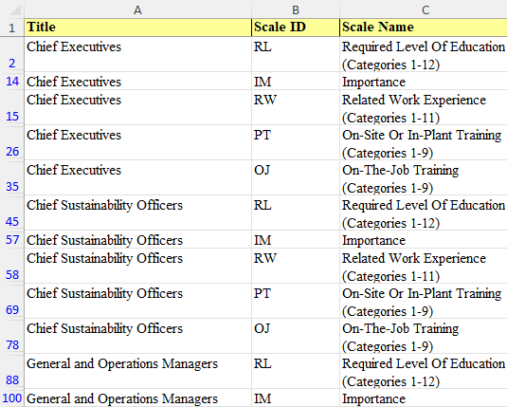
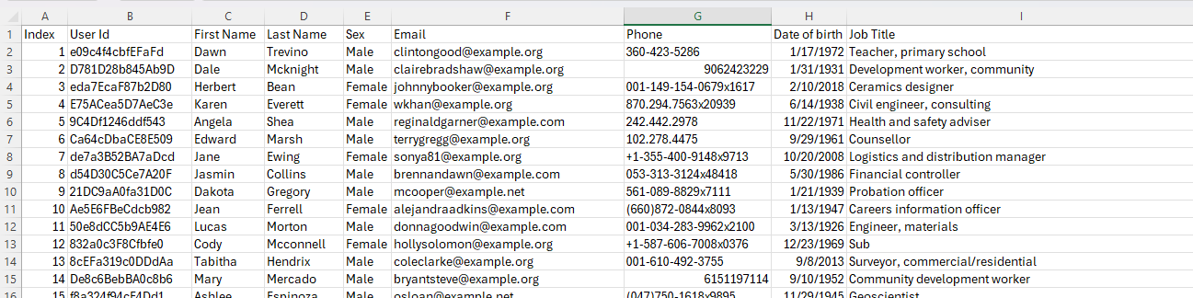
The Data
Source: Download Sample CSV Files for free – Datablist
100,000+ people, job titles, education, gender, age
Fields: Job Title, Date of Birth, Sex, Education Requirement
ONET (Occupational Information Network) is a comprehensive database and system developed by the US Department of Labor that provides information on a wide range of occupations.

Slide 4

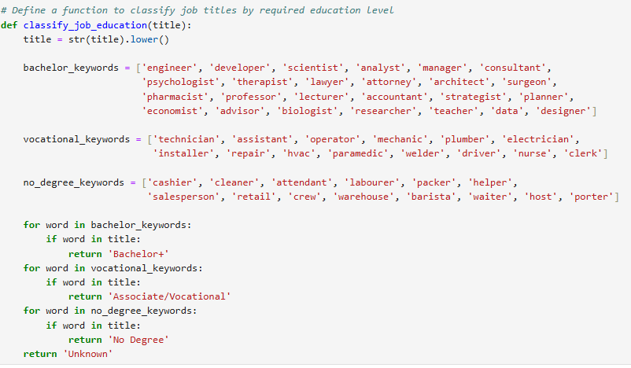
Cleaning It Up
Removed blank or ‘Unclassified’ education entries
Dropped duplicates and unnecessary columns
Standardized education values (e.g. ‘Bachelor’, ‘None’, etc.)
Notes:
I cleaned the dataset by dropping rows with missing or ‘Unclassified’ education values. I also standardized entries to avoid confusion — like combining ‘High School’ and ‘HS Diploma.
I:
Extracted relevant columns (Job Title, DOB, Sex) using Hadoop and Python
Cleaned the data by removing duplicates, nulls, and standardizing education terms
Categorized job titles into levels (e.g., No Degree, High School, Bachelor’s+) using external sources like ONET.
These fields guided our analysis of education requirements, age trends, and gender patterns across job roles.

Slide 5
How I Processed It
Used Python & Pandas in Jupyter Notebook
Used Hadoop to store and access data
HDFS used to load people-100000.csv
Final results exported as a new CSV
Notes:
Loaded data into HDFS via Hadoop
Created and compiled custom Java MapReduce jobs (JobTitleMapper, JobSexDOBMapper, etc.)
Ran Hadoop jobs via CLI (e.g., bin/hadoop jar JobTitleCount.jar /input /output)
Exported outputs as .txt files, cleaned them, and converted them to .csv using Python in Jupyter Notebook
This approach allowed us to handle large datasets and extract filtered results efficiently. For our dataset, Hadoop was enough. But if we scaled this to millions of records or wanted real-time job classification or machine learning, Spark would be the way to go. It’s faster, simpler with PySpark, and much better suited for big data analysis.

Slide 6
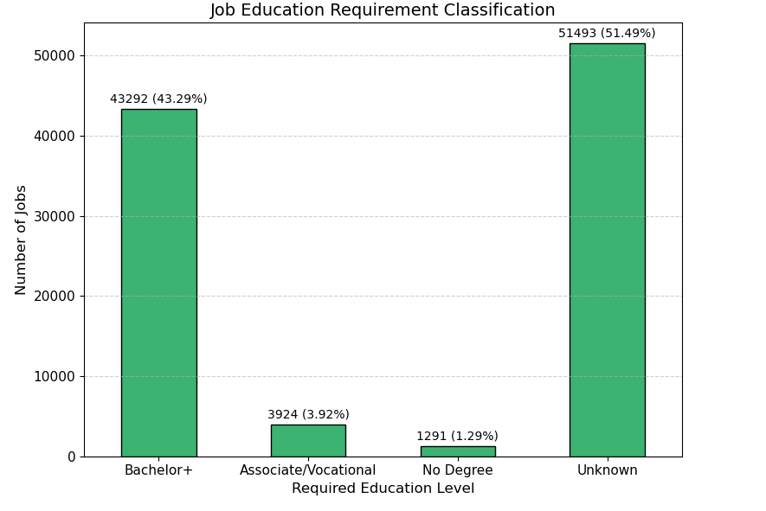
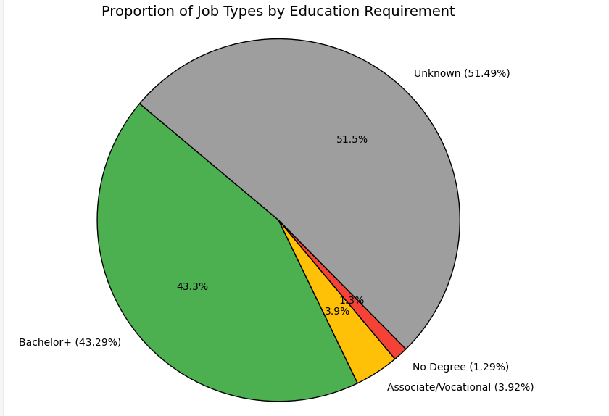
What the Data Shows
Notes:
HW1: Early results showed that many recurring jobs — like Pharmacist, Engineer, and Therapist — suggested college degrees were common.
HW2: After extracting more fields, we noticed age clusters (most degree-required jobs fall in the 25–45 age range), and some gender trends.
Final Project: By categorizing jobs into education levels, we saw that while many roles required a degree, a significant number did not — showing that the job market is more mixed than we initially thought.
Here's what I found. Only about one-third of the jobs needed a college degree. Around 43% required no formal degree at all. The rest mostly asked for high school. This surprised us — I expected more roles to demand a degree.

Slide 7
Using GitHub
GitHub repo hosted all files
Tracked Python scripts, CSVs, screenshots
Helped us manage versions across HW1, HW2, and final
Notes:
GitHub served as our project hub:
We stored and tracked all Java files, Jupyter notebooks, output CSVs, and screenshots
Used branches for HW1, HW2, and final integration
Helped us collaborate and roll back if needed

Slide 8
Final Conclusion
Hypothesis = Partially incorrect
Many jobs don't need a college degree
Takeaway: Skills and experience matter too
Notes:
I expected most jobs to require a degree — but our findings show otherwise. While college helps, many roles didn’t need one. So, the value of skills and experience came through just as strong.

Slide 9
What I Learned
Data doesn’t lie — it challenges assumptions
Technical tools: Python, Hadoop, GitHub
Real experience working with large datasets
Notes:
This project helped us go beyond the classroom — learning how to work with big datasets, debug issues, and tell a story with data. And more importantly, I learned that beliefs can shift when you actually look at the numbers.

Slide 10
Thank you

